Slide 1
High-Level Architecture Review Session
APP-2102: EPIC ADO Pipeline
Robb Morgan
IT Solutions Engineer
CCoE
Architectural Peer Review performed: 06/08/2026
Notes:
Make it more friendly sounding – sharing more than review – Architecture Peer Presentation – Can we make it less scary

Slide 2


EPIC Peer Review: APP-2102 – ADO Pipeline
Virtual Meeting Safety
Know Your Safety Protocols
Share Your Location in Chat
Assign a 30/30 Lead
Ensure Proper Ergonomics
Know Your Evacuation Plan
I’m cared for as a human being
People have my back
I know new ideas are safe to try
I’m not attacked for my ideas
Active Shooter “Get Out/ Hide Out/Take Out”
Earthquake
“Drop/Cover/Hold”
Psychological Safety
Call the Nurse Care Line for any discomfort at 1-888-449-7787
See Something / Say Something: Leader, HR or Compliance and Ethics Hotline 1-888-231-2310

Slide 3
EPIC Peer Review: APP-2102 – ADO Pipeline
Agenda
Safety, Goals, and Ground Rules | 5 minutes | Michael Hansen
Project Overview | 5 minutes | Travis Hayes
Key Requirements Impacting Design | 5 minutes | Robb Morgan
High-Level Architecture Review | 20 minutes | Robb Morgan
Concerns/Follow-Ups | 5 minutes | Michael Hansen
Notes:
Add Safety and groundrules

Slide 4




EPIC Peer Review: APP-2102 – ADO Pipeline
Ground Rules
Out of respect for your busy schedules and the material that we need to review, we will be sticking to the schedule as outlined. Please minimize interruptions of the presenter and rest assured that we will gather concerns at the end of the session.
We are here to help everyone build better solutions. It takes a lot of confidence and humility to stand in front over 100+ people and showcase your work. Let’s support each other and build each other up.
On Time & On Purpose
Be Supportive
We want to make peer reviews efficient and effective. To achieve this balance, we ask that you let the SA present their architecture. However, we do not want you to forget your concerns. All architecture questions from chat will be followed-up by the SA after the session.
You will notice that this Peer Review has no “Board” and no approval process. This is simply a place to engage your colleagues in technical learning, collaboration, and continuous improvement.
Ask Questions (in chat)
We Are Here To Learn
Notes:
No approve. There no board

Slide 5
EPIC Peer Review: APP-2102 – ADO Pipeline
Project Overview
Objective: Provide a clear and concise outline of your project, focusing on the business problems it aims to solve and any compliance dates that must be met. This slide should emphasize the "what" of your project, not the "how.” Feel free to use more than 1 slide for clarity; however, no more than 3 slides should be used for the project overview.
The Project Overview should not exceed 5 minutes
Key Points to Cover:
Basic Premise: Describe the core idea of your project. What is it that you are creating or developing?
Business Problems: Identify the specific business challenges your project addresses. Why is this project necessary?
Compliance Dates: Mention any critical deadlines or compliance dates that need to be achieved or maintained.
Functional Areas: Outline the functional areas the application will serve. Which departments or teams will benefit from this project?
Users/Customers: Define who the end-users or customers of the application are. Who will be using this application?
Business Processes: Highlight the business processes that will be improved or streamlined by this project. What changes or enhancements will it bring?
Note: Avoid discussing technical details of the architecture at this stage. Focus on providing a high-level overview that sets the stage for the technical discussions that will follow.

Slide 6
EPIC Peer Review: APP-2102 – ADO Pipeline
Key Requirements Impacting the Design
Key Requirements and Non-Functional Requirements (NFRs)
This slide should highlight the critical requirements and non-functional requirements (NFRs) that significantly influenced the architecture of your solution. While there may be numerous requirements and NFRs, this slide should emphasize those that were pivotal in shaping your architectural decisions. This should fit on a single slide
The Key Requirements Impacting the Design should not exceed 5 minutes
Focus Areas:
Essential Requirements: Identify the core requirements that the solution must meet. What are the primary needs and objectives that the project aims to fulfill?
Impactful NFRs: Highlight the non-functional requirements that had a major impact on the architecture. These could include performance, scalability, security, usability, and other key considerations.
Decision Drivers: Explain how these requirements and NFRs guided your decision-making process. What architectural choices were made to address these critical factors?
Note: Concentrate on the most influential requirements and NFRs that drove your architectural decisions, rather than listing all possible requirements.
Key Functional Requirements
Place your items here
Place your items here
Place your items here
Place your items here
Place your items here
Key Non-Functional Requirements
Place your items here
Place your items here
Place your items here
Place your items here
Place your items here

Slide 7
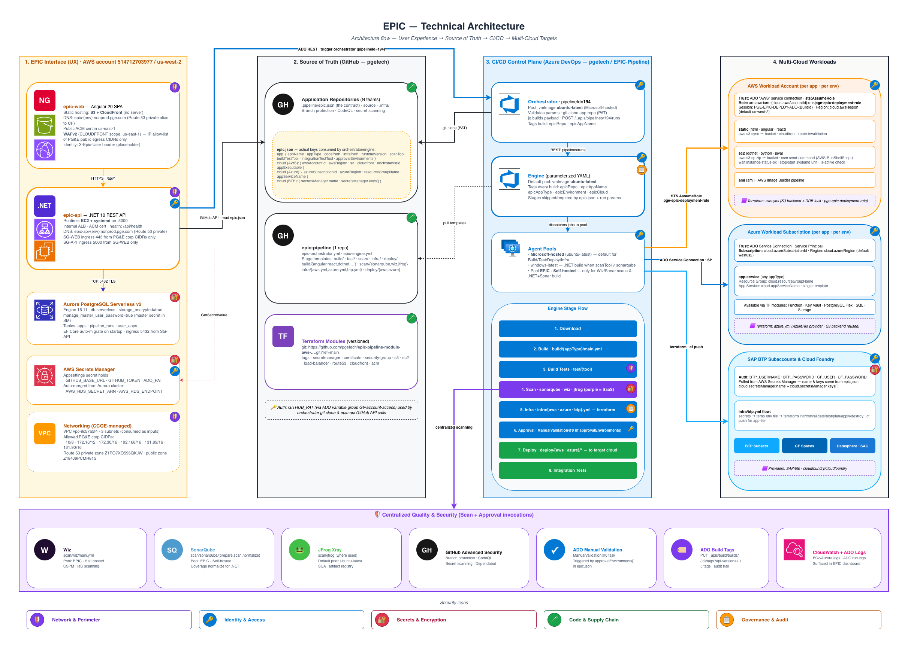
EPIC Peer Review: APP-2102 – ADO Pipeline
High-Level Architecture Diagram
Notes:
Pre-read

Slide 8

EPIC Peer Review: APP-2102 – ADO Pipeline
Concerns / Follow-Ups
Are there any concerns with the architecture that you would like to have a follow-up conversation with the Solution Architect?
Speak up now (or added it to the chat) so that we can follow up on your concerns after this session concludes.

Slide 9



EPIC Peer Review: APP-2102 – ADO Pipeline
Appendix: Resources
The purpose of this slide is to provide the audience with essential resources to further explore the architecture you have presented. This slide should include:
The Resources slide will not be presented during the presentation agenda. This slide deck will be added to chat at the conclusion of the Peer Review as a resource for others.
Project Documentation: Provide links to comprehensive project documentation where detailed information about the architecture and other aspects of the project can be found.
High-Level Architecture Diagram: Include a link to the High-Level Architecture (HLA) diagram for a visual representation of the design.
Key Contacts: List key contacts who can address any questions or concerns that were not covered during the presentation or in the Concerns/Follow-Up section.
Please delete this text box once you are clear on the purpose of this slide
Project Documentation
High-Level Architecture
Project Contacts
Place links to your project documentation here
Place a link to your Lucid Diagram of your HLA here. (Sharing for the link should be for all licensed users at PG&E an should include Comment rights)
Place your key project contacts here

